Slide 1


Math285 Lab
Team10:Shihong Yuan, Chenyi Wang,
Kerui Zhang , Wubing Xia, Binghe Li
ZJU-UIUC INSTITUTE
Zhejiang University/University of Illinois at Urbana-Champaign Institute
浙江大学伊利诺伊大学厄巴纳香槟校区联合学院

Slide 2
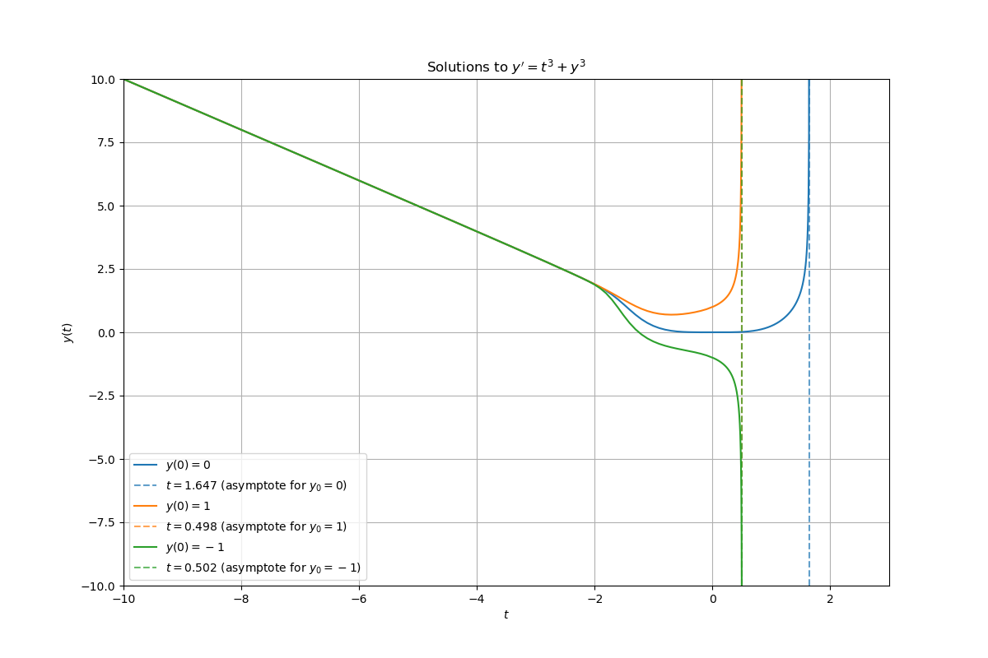

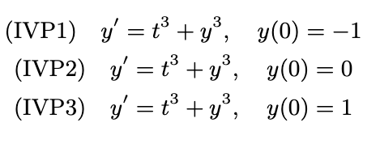
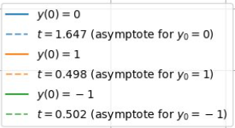
Introduction
Firstly, To estimate the asymptote for y′=y^3+t^3,y(0)=1, we give it an upper bond, which is y′=y3+1, and then get t is larger than it's similar to the books' solution, and after iteration, the final blow-up point is t≈0.498.
And then we approximate the solution of the differential equation using five distinct methods, analyze the error of each, and provide a comparison.
Euler
Improved Euler
Picard-Lindelof Iteration
Power series
Runge-Kutta

Slide 3
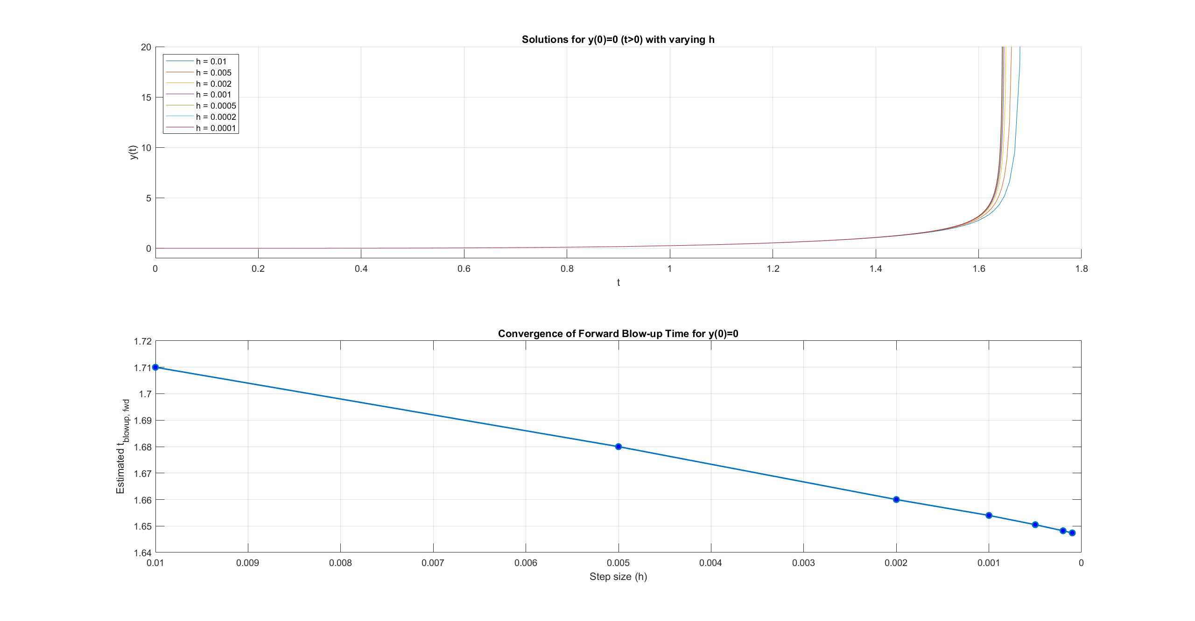
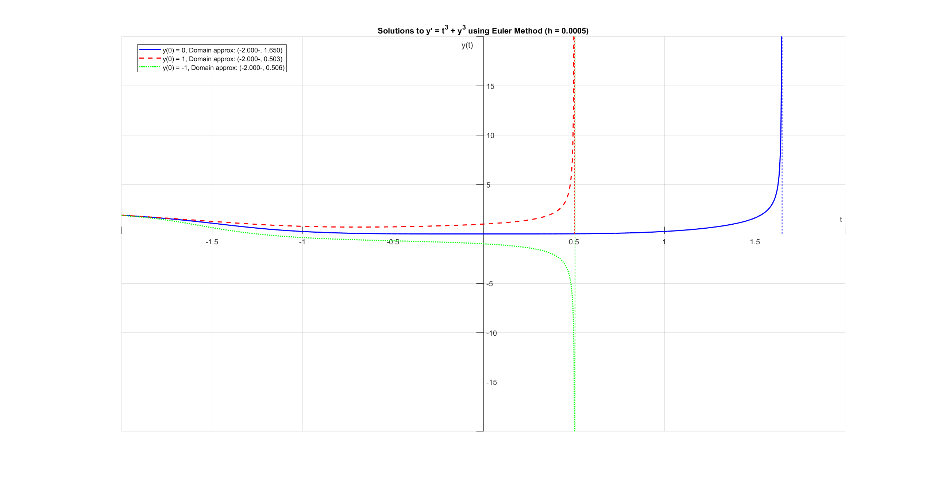
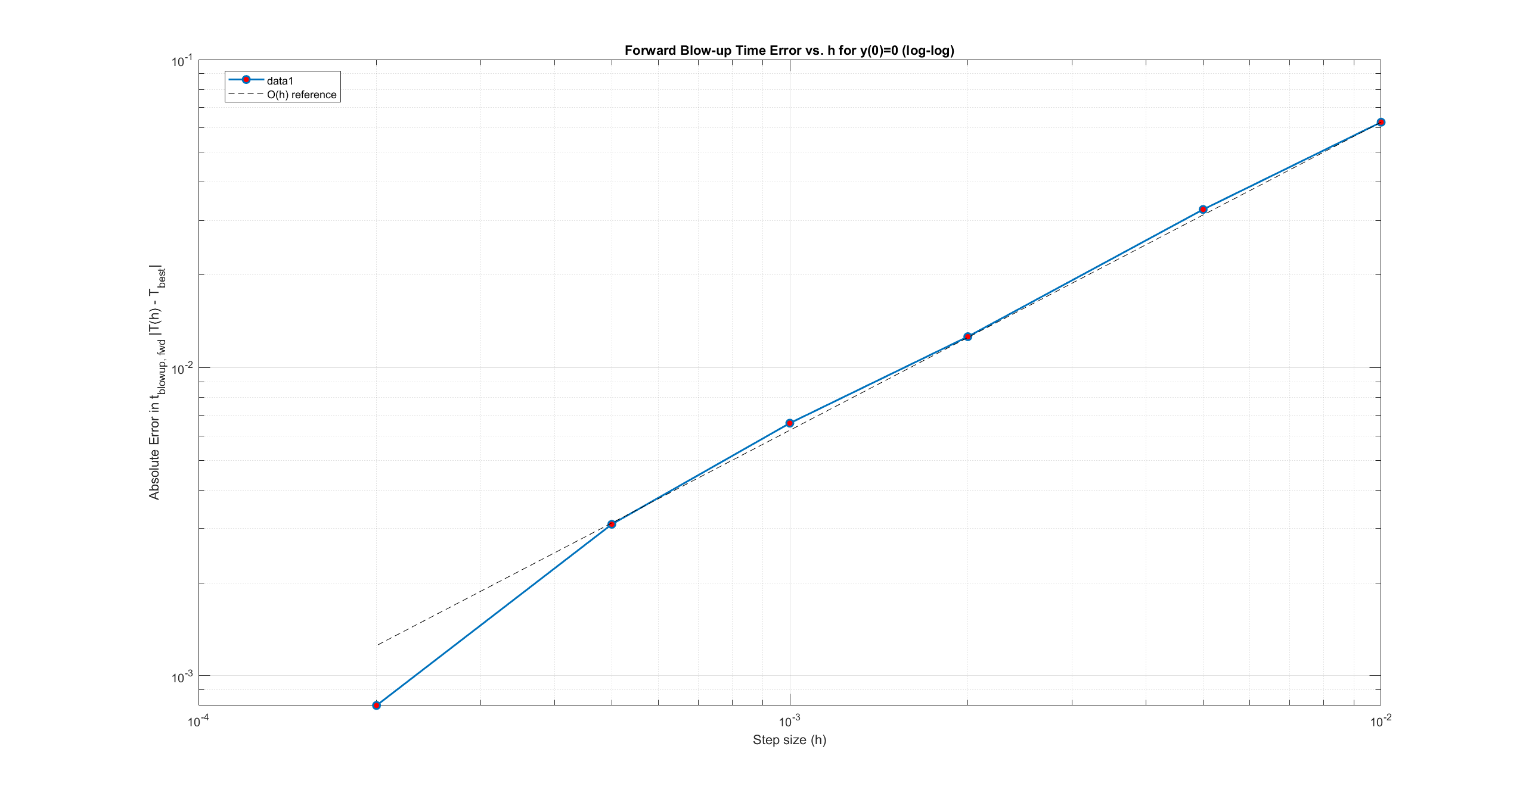
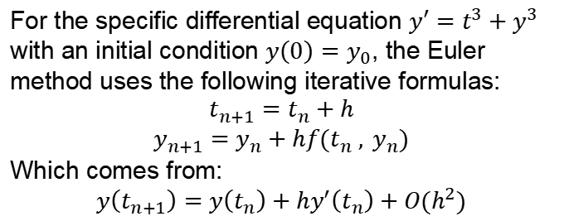
Sol1: Euler Method
For the specific differential equation $y′=t^{3}+y^{3}$ with an initial condition $y\left(0\right)=y_{0}​$, the Euler method uses the following iterative formulas:
$$t_{n+1}=t_{n}+h$$
$$y_{n+1}=y_{n}+hf(t_{n} , y_{n})$$
Which comes from:
$$y\left(t_{n+1}\right)=y\left(t_{n}\right)+hy^{′}\left(t_{n}\right)+O(h^{2})$$
Notes:
The first method we used to solve the differential equation is the Euler Method. It approximates the solutions to IVPs of the form y’=f(t,y) with a given initial condition y(t0)=y0.
H is the step size, (tn​,yn​) is the approximated solution at the n-th step
The Euler method is derived from the Taylor series expansion of y(t) around tn. So in this case we neglect the O(h^2) term which means that we can get smaller error if we reduce the size of h.
In the plot on the top, we can see that if we reduce h to an extent, the curve of y(t) will converge and we can find an accurate estimation of blowup point.
In the plot in the bottom, we fitted the error corresponded to different h. Also we found that the error decreases as we decrease h.

Slide 4
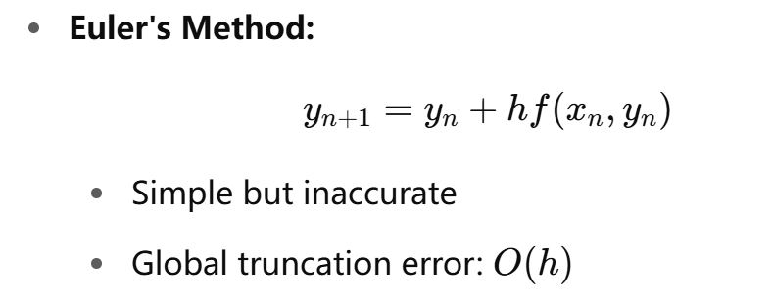
Sol2: Improved Euler Method
Improved Euler Method
A Second-Order Method for Solving Initial Value Problems
Why Improved Euler Method?
Motivation: → Improve accuracy without much added complexity → Correct the slope using both the start and the end of the interval
Notes:
Hello everyone. Today I will introduce the Improved Euler Method, also known as Heun’s Method, which is a second-order numerical method for solving initial value problems.
Let’s first look at why we need it. The basic Euler’s method is simple, but not very accurate. It only uses the slope at the beginning of the interval, which leads to a global error of order O(h)O(h)O(h).
The motivation behind the Improved Euler Method is to increase accuracy without adding much complexity, by using an average of the slopes at both the beginning and end of each step.

Slide 5

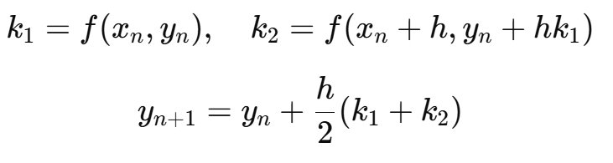
Sol2: Improved Euler Method
Improved Euler Method – Algorithm

Slide 6
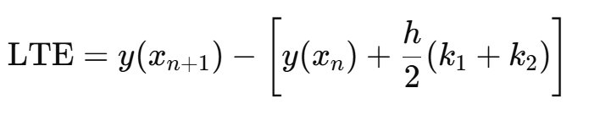
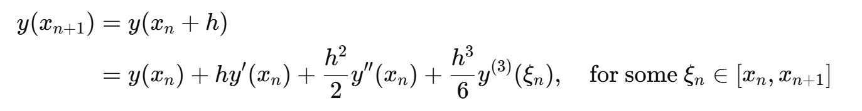
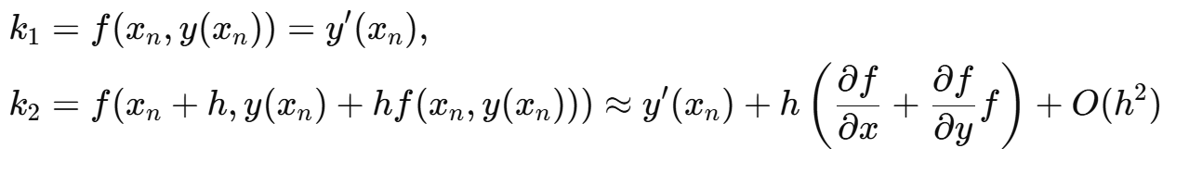
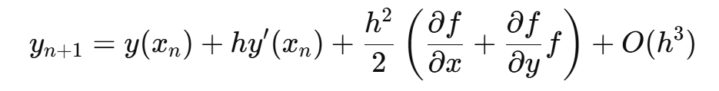
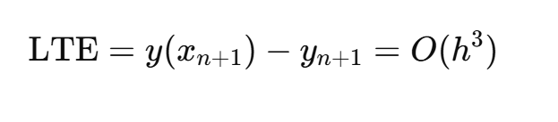
Error Analysis —Local Truncation Error

Slide 7
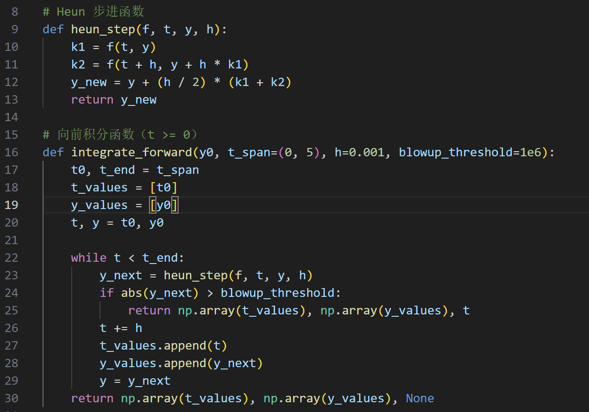
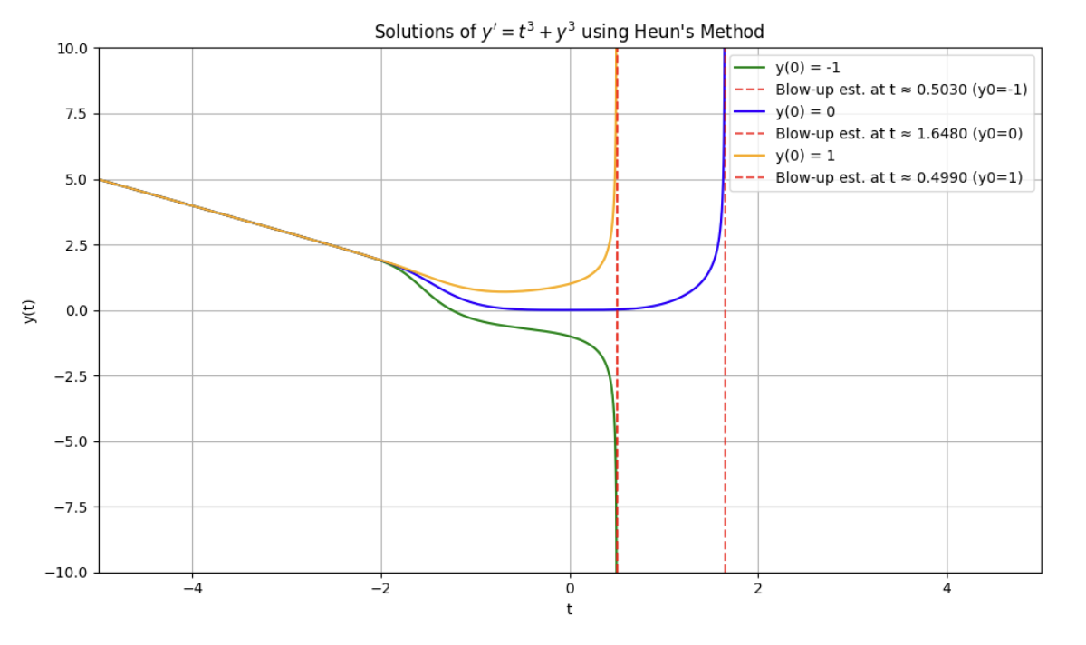
Implementation
Function integrate_forward Integrates the ODE forward in time:
Starts from initial value y0y_0y0
Repeats heun_step until the final time is reached
Appends each time and solution value to arrays
Stability check Terminates early if the solution magnitude exceeds a threshold

Slide 8
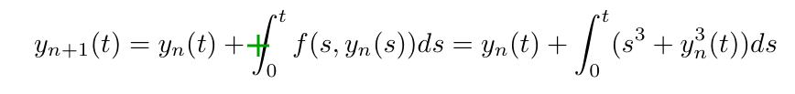
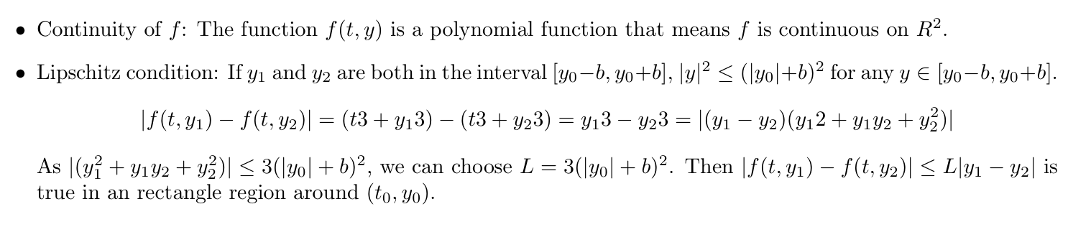
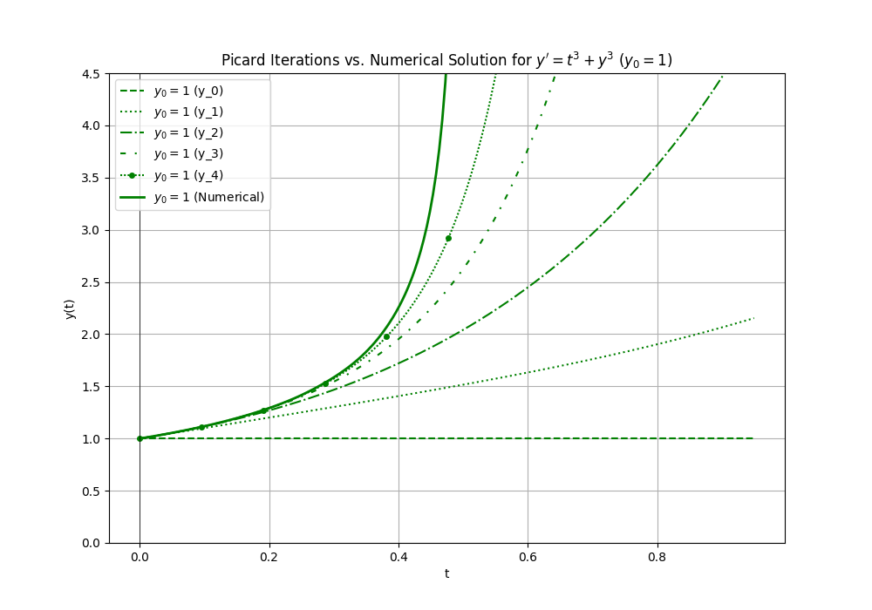
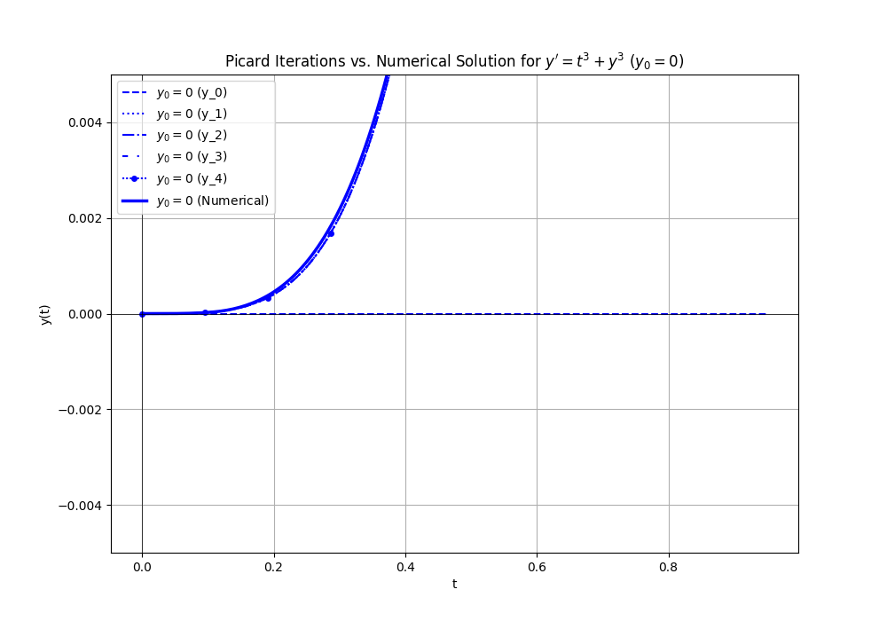
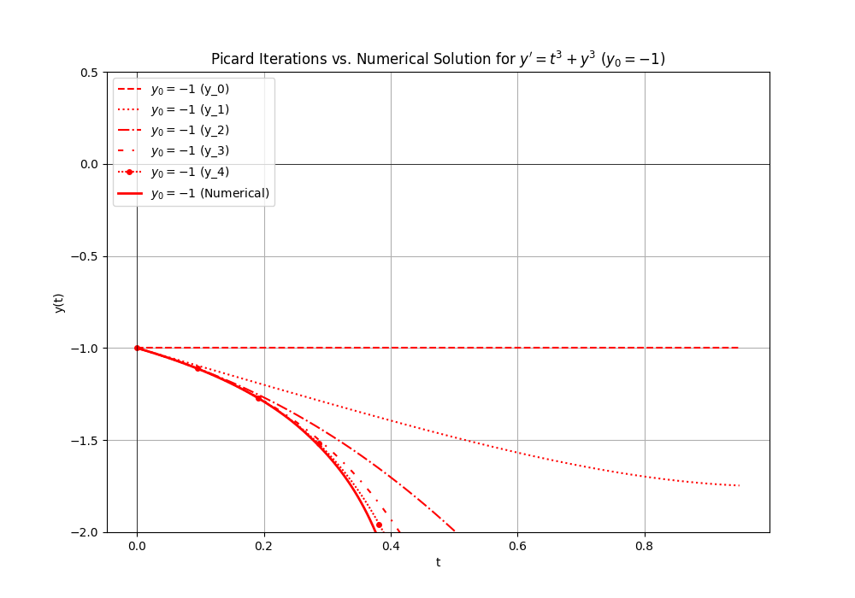
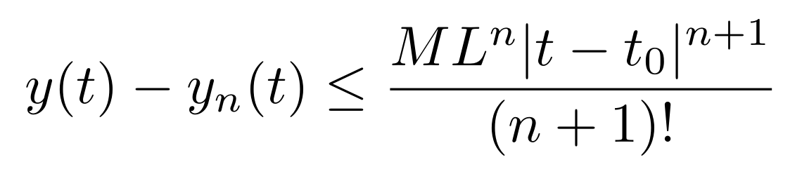
Sol3: Picard-Lindelof Iteration

Slide 9


Sol4: Series Method
Series Method wants to use a power series solution to fit a ODE and use Initial Value to solve the coefficiency of each item.
The basic form of the series solution is shown below.
In this IVP, we need to obtain the following series, which could be solved by using nth derivative.

Slide 10
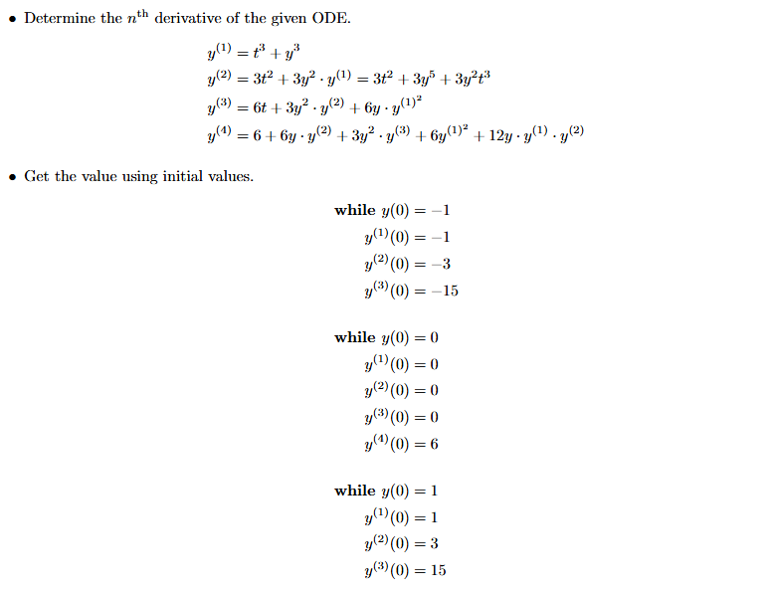
Sol4: Series Method
There are two methods to get that.
Method 1:

Slide 11
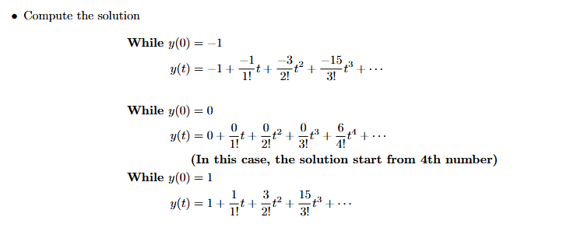
Sol4: Series Method
There are two methods to get that.
Method 1:

Slide 12
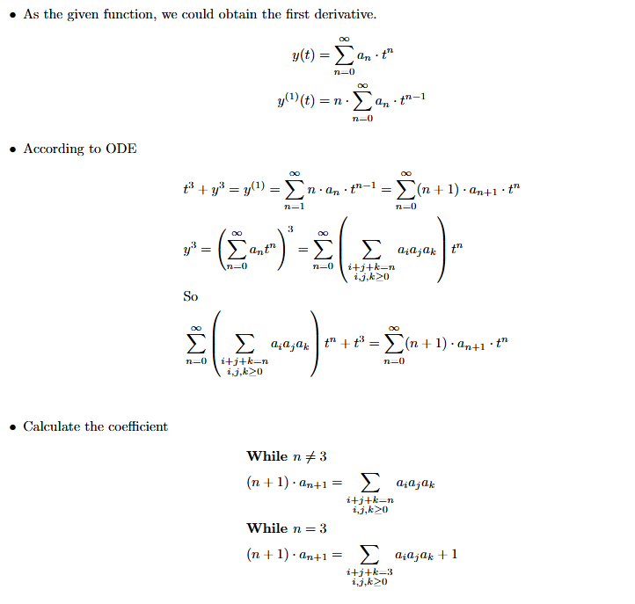
Sol4: Series Method
There are two methods to get that.
Method 2:

Slide 13
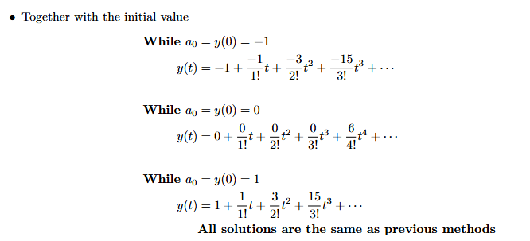
Sol4: Series Method
There are two methods to get that.
Method 2:

Slide 14
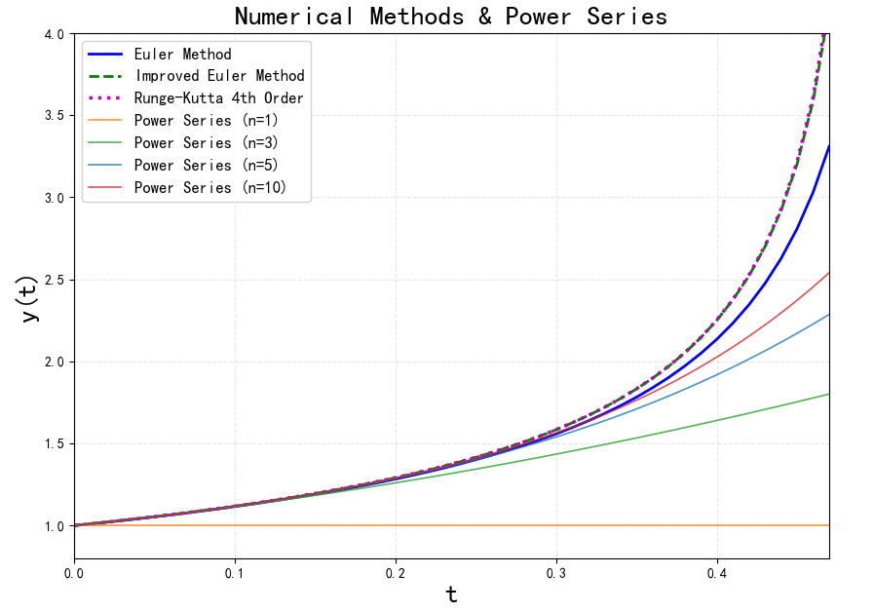

Sol4: Series Method
Because we can not show all item in calculation, so there will be some error.
We use y(0) = 1 as an example.

Slide 15

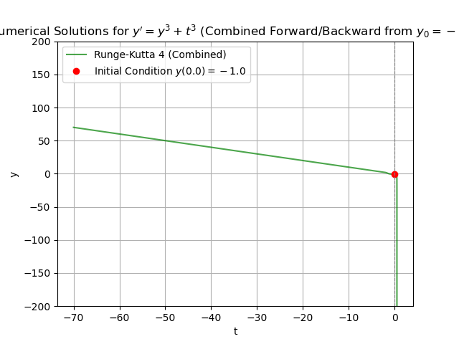
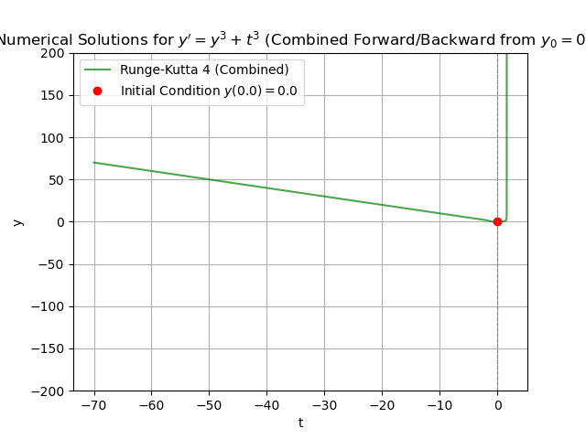
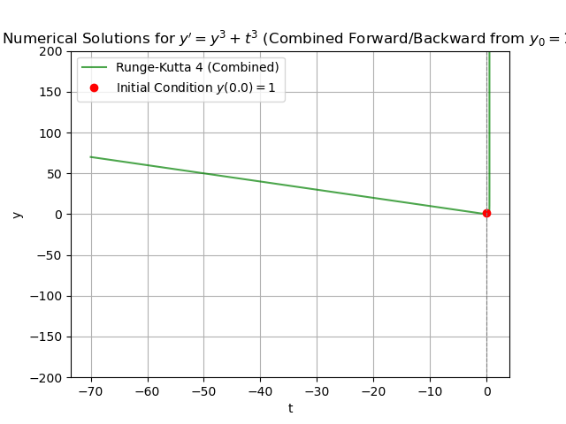
Sol5: Runge-Kutta Method

Slide 16
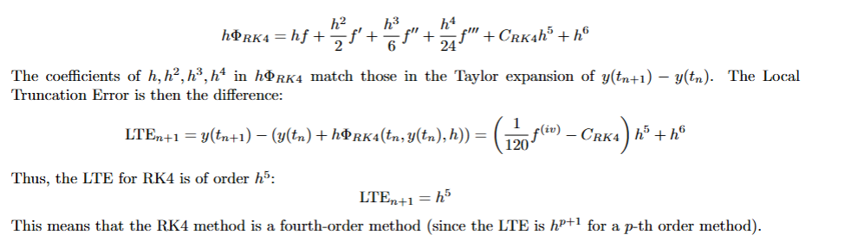
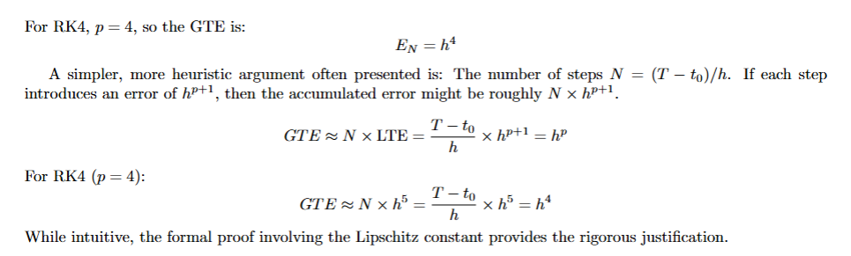
Sol5: Runge-Kutta Method
Error analysis

Slide 17
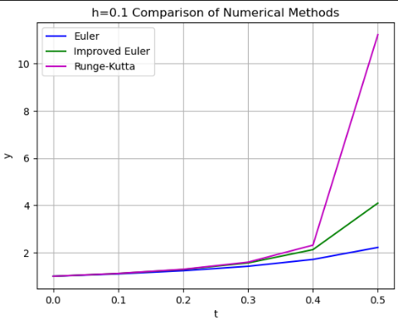
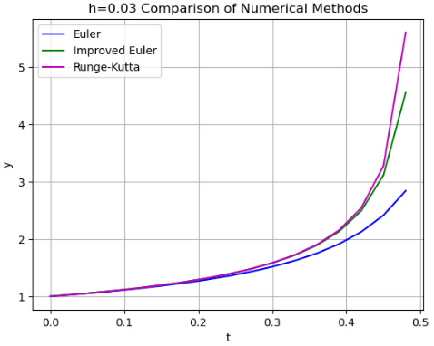
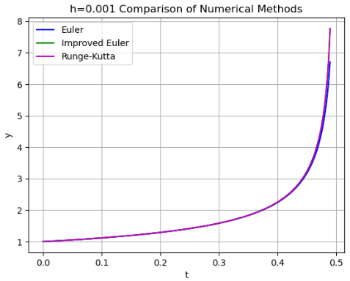
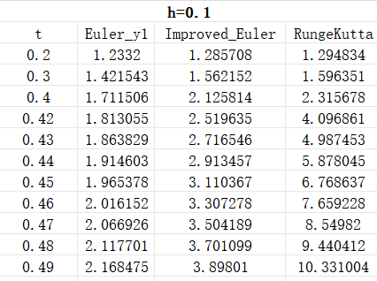
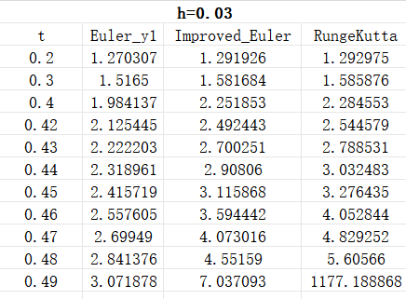
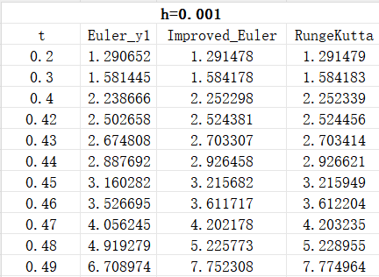
Comparison on steps and methods
Notes:
1 Runge That’s the same as our error analysis.
2 less h, less difference

Slide 18
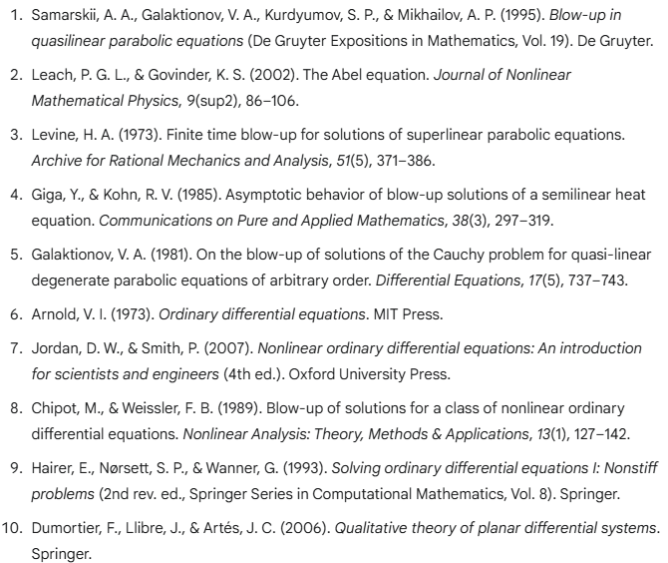
Reference and Acknoeledgements
References
Ackonwledgements
Firstly, I'd like to say thank you to Professor Honold for assigning such an interesting task that we have learnt a lot. Then I would like to express my gratitude to all the TAs, especially TA Ren Jiashen for giving us lots' of instructions on the lab report. Thirdly, I have to say thank you to AI the Gemini, as it serves as a good coding helper for us to modify our code.

